Slide 1
AI Sessions
Designed for NEOM AI Challenge students

Slide 2
What is AI?
"the science and engineering of making intelligent machines.“ John McCarthy
“A broader idea where machines can execute tasks smartly and simulates human-intelligence in machines.” Manjeet Rege
“the science of making computers do things that require intelligence when done by humans. ” Jack Copeland

Slide 3
What is AI?
Making Machines, Act Like Human Beings

Slide 4
AI Subfields:
Machine learning: it uses different algorithms to find hidden insights in data
A neural network: inspired by human brain. It’s made up of interconnected units/neurons that processes information by responding to external inputs, and pass information between each unit.
Deep learning: huge collection of neural networks with many layers of processing units, requires extremely powerful computing power, to learn complex patterns in large amounts of data.
Many others..

Slide 5
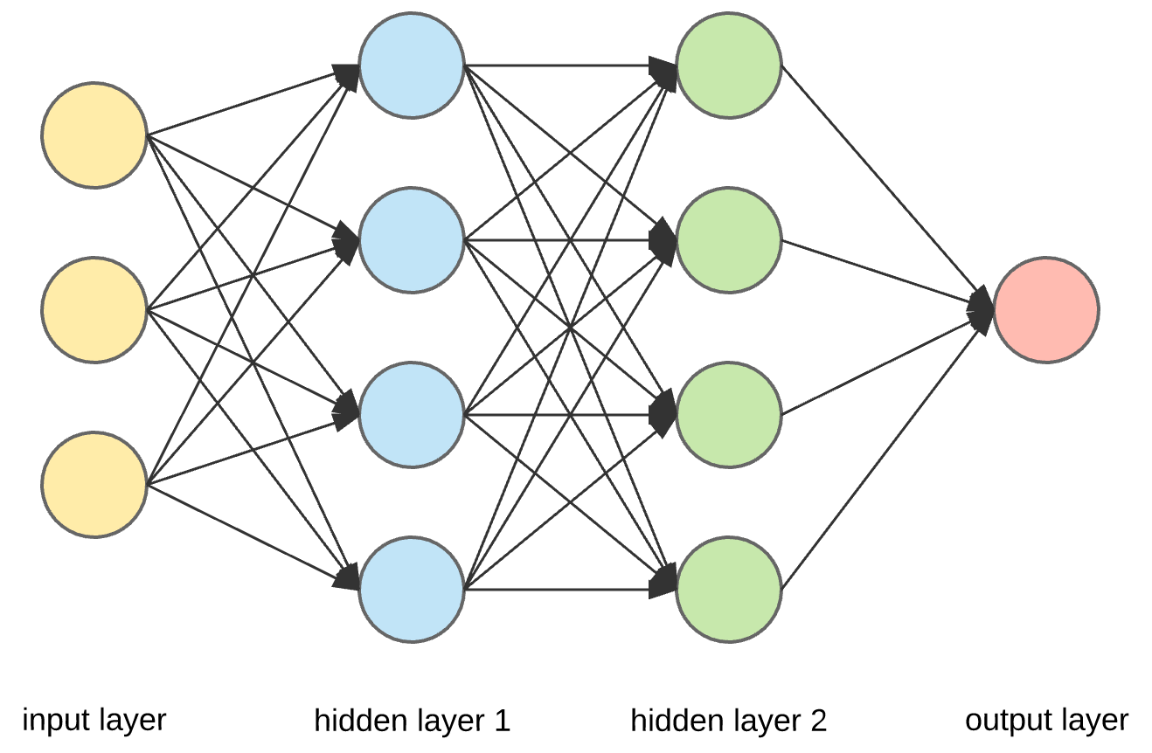

Slide 6
Deep Learning

Slide 7
Deep Learning
Machine Learning

